Slide 1

Who’s Home
Michael Blake, Patrick Caruana, Caleb Kauffman, Cris Laney

Slide 2
Overview
Project Summary
Client overview
Server overview
Live Demo
Going Forward

Slide 3
Who’s Home Project Summary
Roommate and Family communication app
Bulletin board
Track bills
Create checklists
See roommates at common locations

Slide 4
Client Overview
Caleb Kauffman, Cris Laney

Slide 5
Technologies
Xamarin for Visual Studio
Android
C#
XML

Slide 6
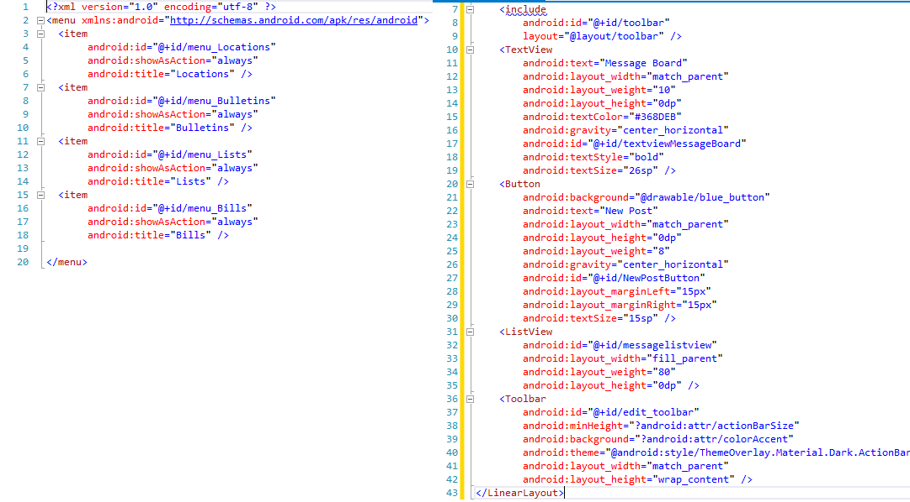

Slide 7
Features
Welcome screen
Sign up
Sign in
Top and bottom menu bars
Bulletins
New post
List of posts

Slide 8
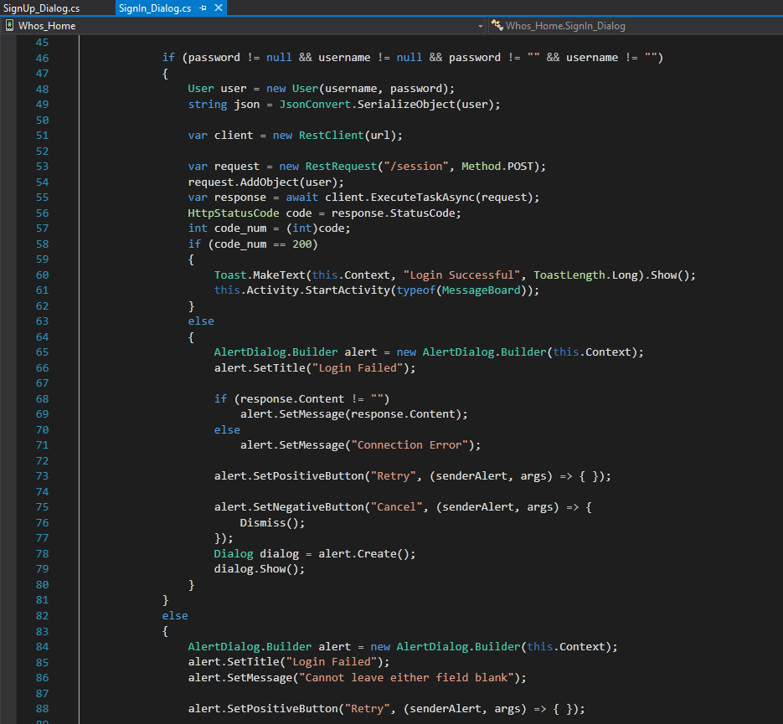
Sign In
Request
Grabs text from all fields
Add text to a user object
Translate it into a JSON formatted string
Send in POST request
Response
Read Status Code
Display errors if any

Slide 9
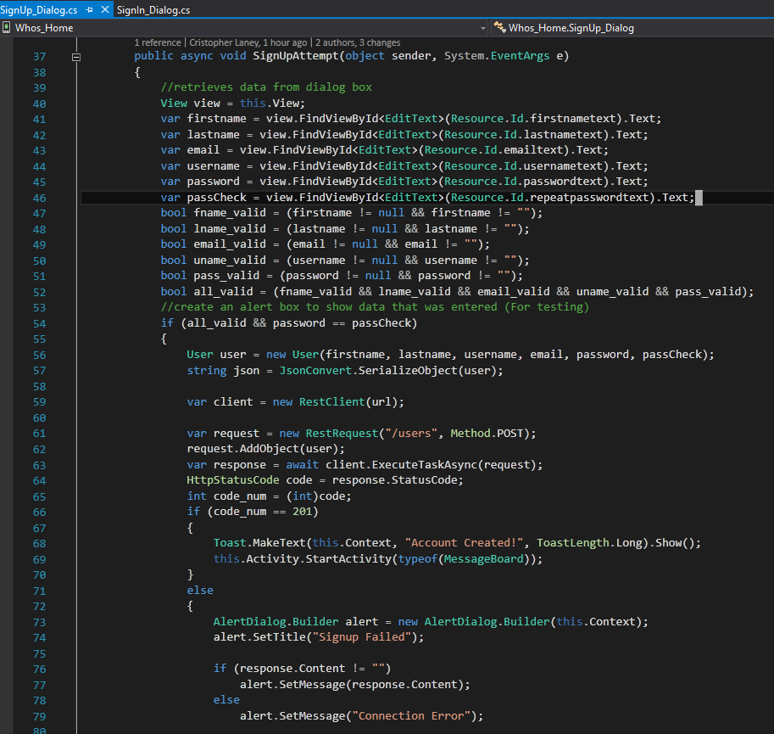
Sign Up
Request
Similar to Sign In, but many more fields
Some simple input validation
Response
Recieves response and displays any necessary information

Slide 10
Devops (A necessary evil)
Server Issues
Git Issues
.gitignore
Xamarin Issues
Emulator and Debugger
Database Rebuilds
Allows for Hash and Salt

Slide 11
Server Overview
Michael Blake, Patrick Caruana

Slide 12
File Structure
|App.js
|Config.js
|--- Session
| |--- login.js
|--- Users
| |--- signup.js

Slide 13
User Signup
Retrieve user information through POST
Check if user data is valid
Check if username/email exist
Insert into database

Slide 14
User Sign In
Retrieve user login information through POST
Check if user data is valid
Query database to receive salt
Hash and salt password
Compare hashed password with that stored in database

Slide 15
Sign In Example Request
POST http://12.34.456.789:3000/session/
Username=exampleuser&Password=somepassword
Response:
Sign in successful
OR
Invalid username or password

Slide 16

Testing
Easy implementation through Visual Studio 2015 and Node.js Tools
Mocha for the testing framework and Chai for the assertion library
Testing for modules created this sprint (users, sign in)

Slide 17
Live Demo

Slide 18
Going Forward

Slide 19
Sprint #3 (Winter Term)
Implement token for authentication and persistent login
User preferences
Group creation and management
Implement bulletin (Server/Client/Database communication)

Slide 20
Question | Comments

